Slide 1

ClassInsight: An agentic AIEd application for responsive teaching
Talia Berler
tkb40@miami.edu
M.S. of Data Science
University of Miami 2025
ClassInsight
Notes:
- Introduction: name, school/degree
- title: developing ClassInsight, An agentic AIEd (AI Educational) application for responsive teaching

Slide 2
AGENDA
01
Problem Statement
02
Solution
03
Prototype
04
Methodology
05
Results
06
Conclusion & Significance
ClassInsight
Notes:
- read agenda

Slide 3
PROBLEM STATEMENT
Responsive teaching
  Individualized > General
  Real-time > Delayed
  Humanities
Traditional Approaches
  Questions
  Discussion
  Quiz
ClassInsight
Notes:
- Responsive teaching is a teaching method that adjusts instruction to meet the needs of each student, and is a key component of effective pedagogy
- It involves providing individualized feedback and instruction, which has been proven to be a more effective approach than generalized feedback to the class as a whole.
- Another critical component of responsive teaching is providing feedback and adjusting instruction in real-time, rather than after a period of time. The faster that instruction is adjusted, the greater the impact on student learning outcomes.
Big challenge particularly in humanities subjects, which often rely on free text assessments to check comprehension. It takes educators longer to review free response exercises than something like multiple choice or fill in the blank.
Traditional approaches to assessing comprehension do not sufficiently address the issue.
Asking a question to the class usually results in confident students responding
Discussions frequently face the same issue
Quizzes take a long time to grade and return feedback on, reducing the efficacy of said feedback

Slide 4

SOLUTION
ClassInsight
Inputs
Educator provides:
1. Email List
2. Question
3. Model Response
4. Categories
Outputs
2 Main Products:
1. Quantitative: aggregated, anonymous visuals
2. Qualitative: individual feedback
ClassInsight
Notes:
The solution I present is the ClassInsight application. The app provides another option for assessing classroom comprehension in real-time, giving educators and students essential insights on overall understanding of in class material.
It is integral to point out, ClassInsight is not meant to be a grading tool, rather a checkpoint for instructors to get a sense of student’s understanding. This reduces any urge to cheat on ClassInsight exercises.
- The application takes the following inputs from the educator:
- ClassInsight then produces the following outputs:

Slide 5
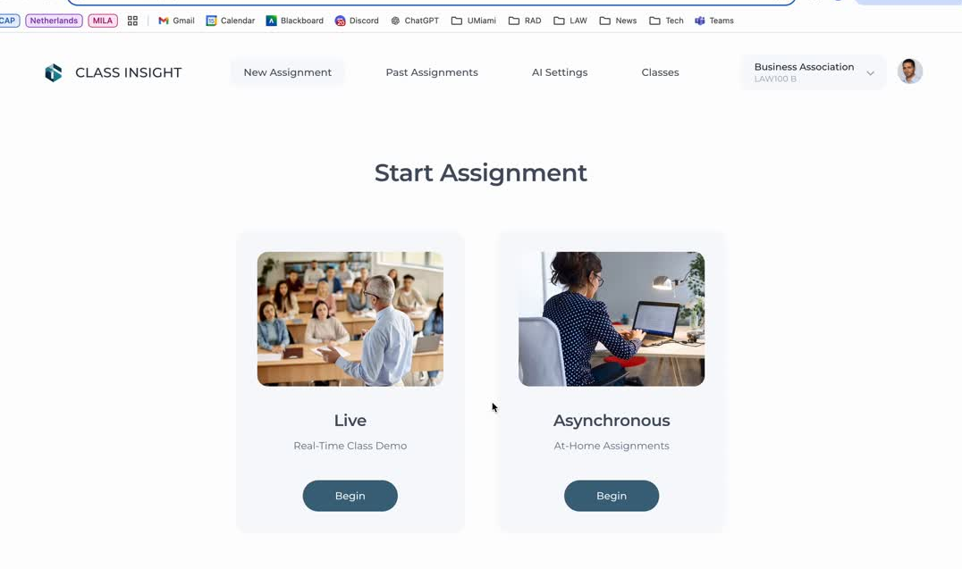
Notes:
- this is a video of a prototype of the application's user interface, still under development

Slide 6
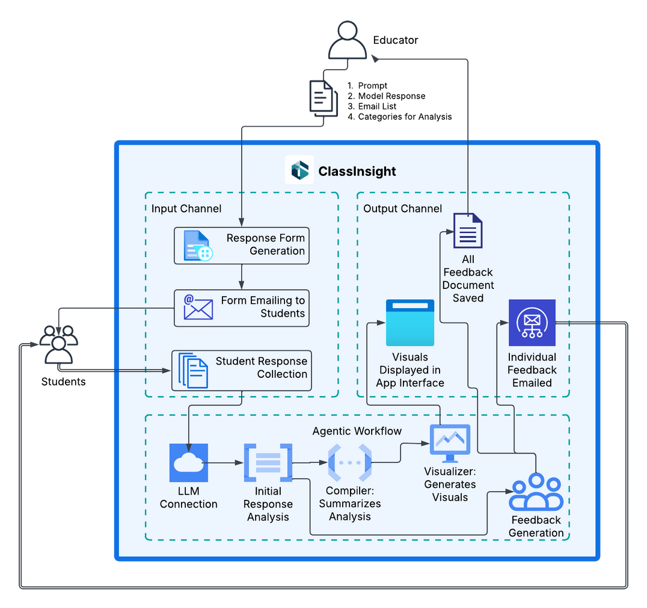
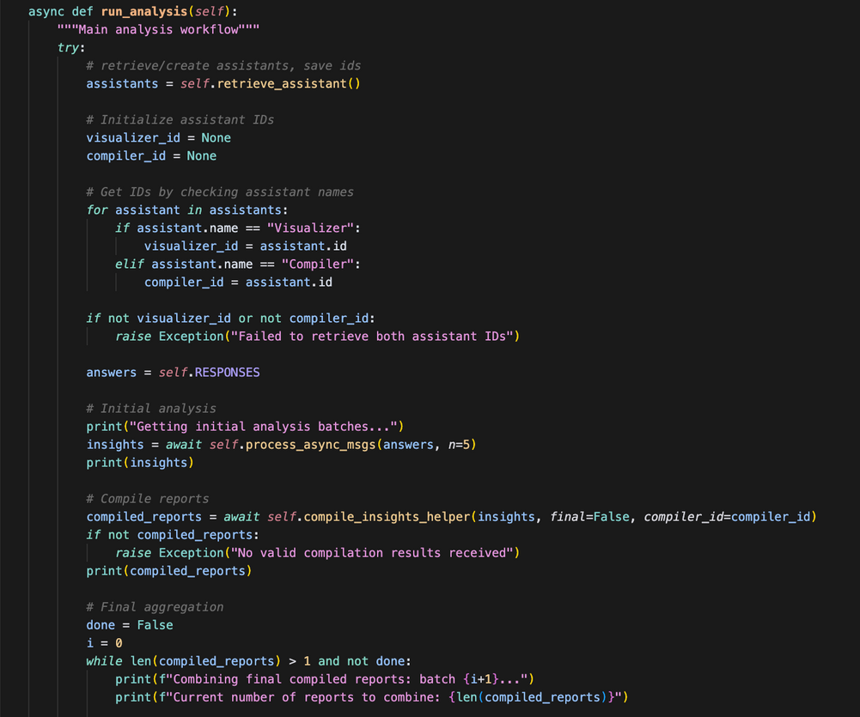
METHODOLOGY
Notes:
- I'm going to go through a brief explanation of the software architecture underlying the ClassInsight application
explain: input channel,
agentic workflow: series of connected, dynamically executed steps performed by AI agents to achieve a specific task or goal, leveraging the agents' ability to reason, use tools, and learn from experience
output channel
- code snippet on the right displaying a portion of the AI analysis of responses

Slide 7
RESULTS
Performance
Demos
Accuracy
Classrooms and educators
  Incorrect and partially correct responses: CV ~5%
  Correct responses: CV ~50%
  Larger batch sizes → improved accuracy
  PETAL conference
    Batch size: 10 and 25
  UM law classes
    Batch size: 70 and 80
Notes:
- ClassInsight has only been in development for a few months, so as of now we are just beginning to start formal testing on the accuracy of the analysis
- initial results on dummy data indicates highly stable accuracy on identifying incorrect and partially correct responses, with a coefficient of variance around 5% across different batch sizes of input
- there is greater variability with identifying correct responses, with about 50% CV across batch sizes
- we have already noted that larger batch sizes, or more responses entered, results in improved accuracy
- thus far we have already run demos for small groups of educators and relatively large classes in the law school

Slide 8

CONCLUSION & SIGNIFICANCE
Real time assessment for responsive teaching
Timely feedback improves education
ClassInsight empowers educators and students
ClassInsight
Notes:
- tie back to problem statement:
- offers capability for real-time assessment
- Individualized feedback with minimal delay leads to improved learning outcomes
- helps educators identify areas of weakness in comprehension and make adjustments by returning to these areas or adjusting their approach, AND unexpected outcome...
- more students asked questions in class following the exercises than were participating previously

Slide 9
ClassInsight: An agentic AIEd application for responsive teaching
Thank you!
Talia Berler
tkb40@miami.edu
M.S. of Data Science
University of Miami 2025
ClassInsight

